Slide 1

Talent Management Solutions for Fortune 100 Companies
Paritosh Rai
SMU Data Science
GitHub: https://github.com/paritoshrai/CaseStudy2DDS
Youtube: https://youtu.be/WEzkAYl0yoM

Slide 2


Objective of Case Study
Factors that lead to attrition
Top three factors contribute to attrition
Job specific trends
Model to predict Monthly Income
Model to predict attrition
Key Find
DDS to leverage Data Science talent to manage the resource
Find prime cause of attrition and managing the attributes
Carry out pre-analysis to find factor driving attrition
Build predicting models

Slide 3

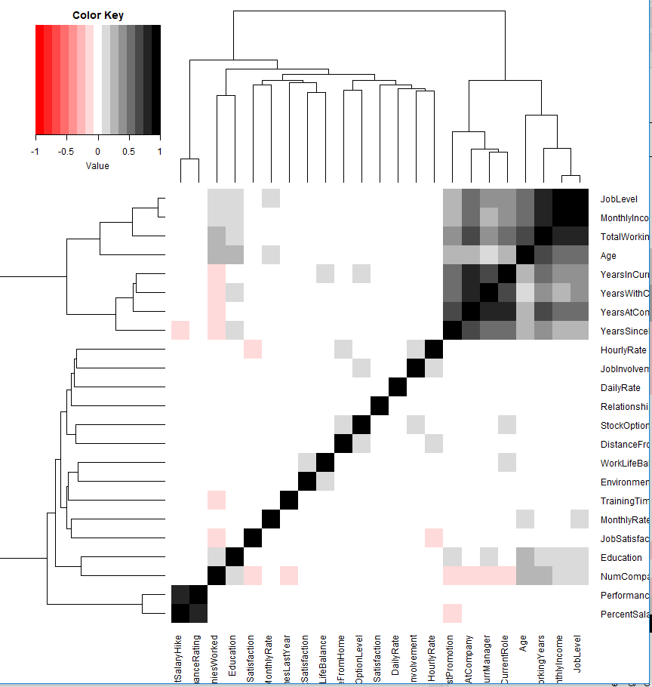
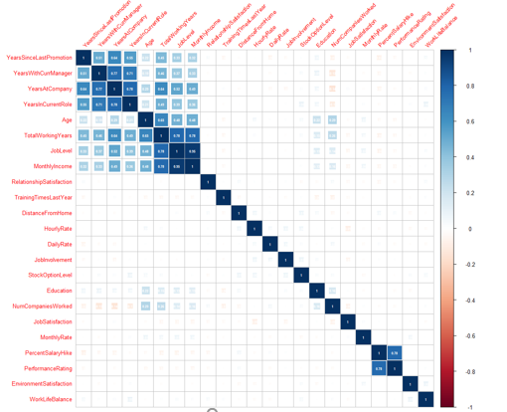
Heat Map and Correlation Map
Heat Map
Highly Correlated Attributes
Correlation Map
Years at Company
Years in Current Role
Years since Last Promotion
Years with Current Manager
Total Working Years
Monthly Income
Age
Job Level
Highly Correlated Attributes Table

Slide 4

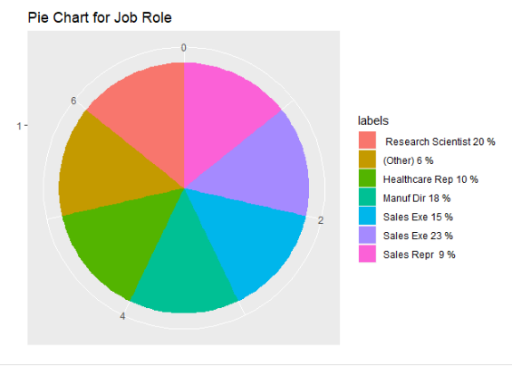
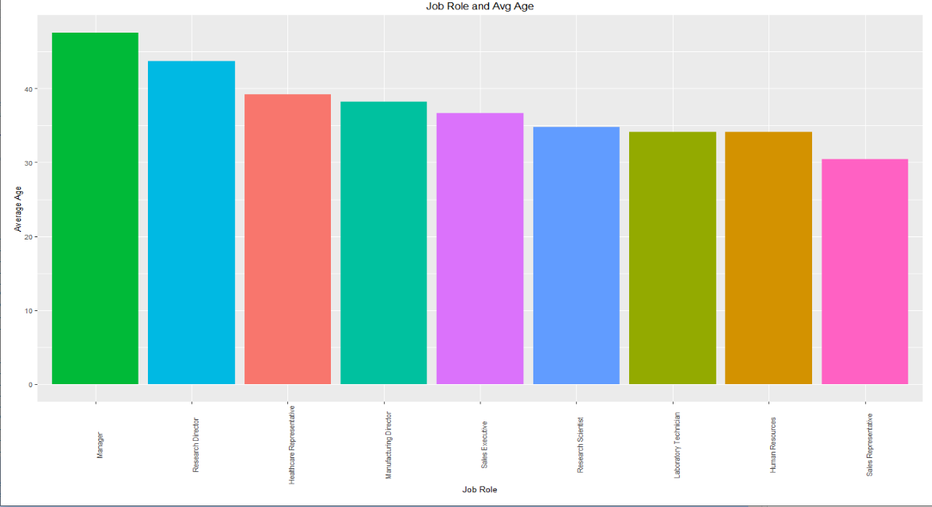
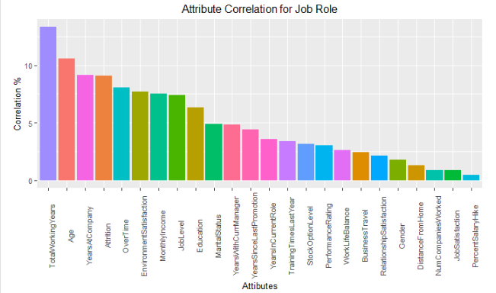
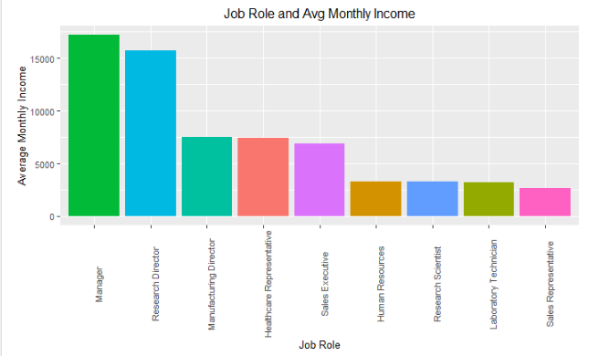
Job Role Trends
Age vs. Role
Summary:
Manager and research directors are highly paid roles.
Average age is flat however mangers and Research are at higher end.
Gender distribution is very constant across the role. Male is 50% to 65%
Role Correlation
Monthly Income vs. Role
Gender vs. Role

Slide 5

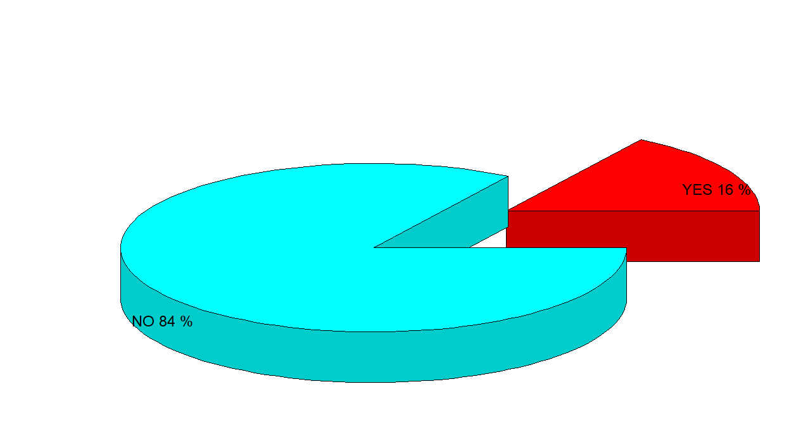
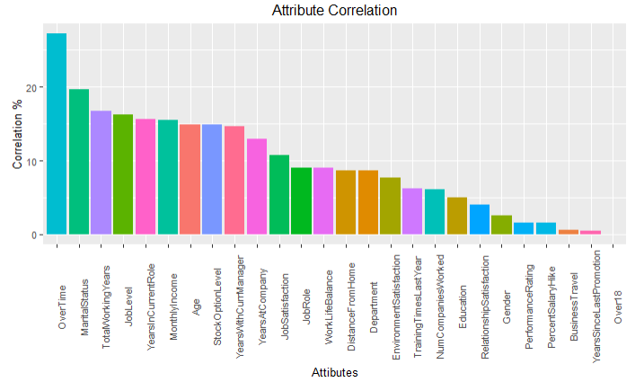
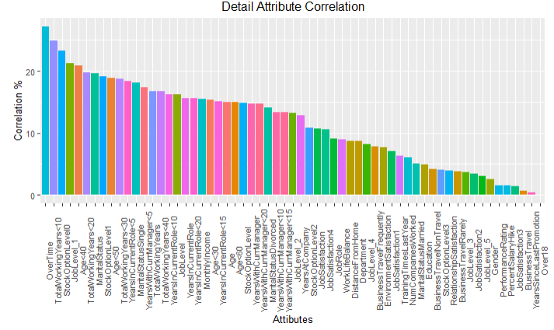
Top Factors that Lead to Attrition
Attrition rate is 16%
Summary:
Top three factor contributing to Attrition are:
Over Time (Positive correlation)
Marital status Single (Positive correlation)
Low number of working years (Negative correlation)
Other factors like young employees, low job levels, and low stock options also contributed to attrition
Attrition shows high correlation with Over Time (+) , Marital Status (+), Total Working Years(-).
Followed by Job level (-), Years in current role(-) and Monthly Income(-)
Attrition shows high correlation with Over Time , Total Working Years<10, and Stock Option =0.
Followed by low Job Level, Age<40, and Total Working Year<20.

Slide 6

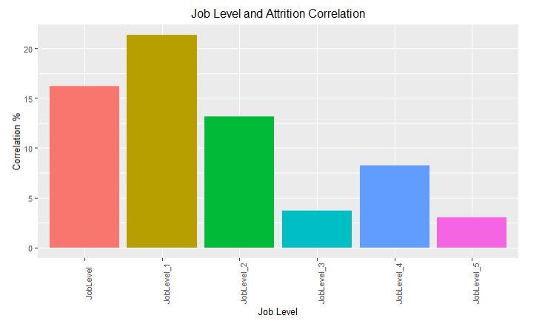
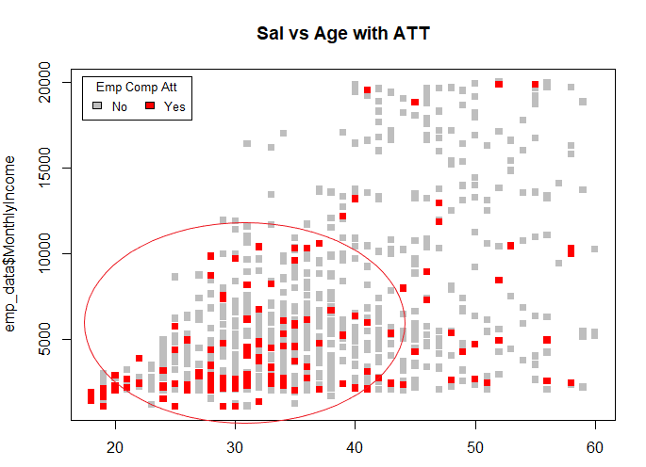
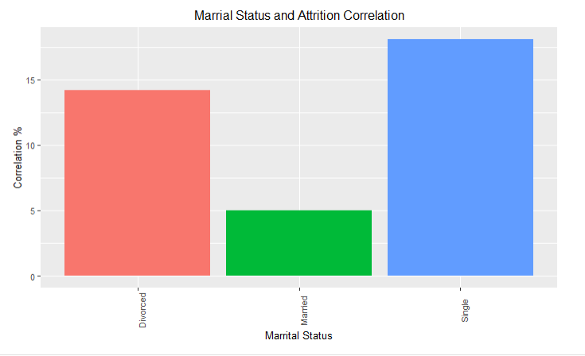
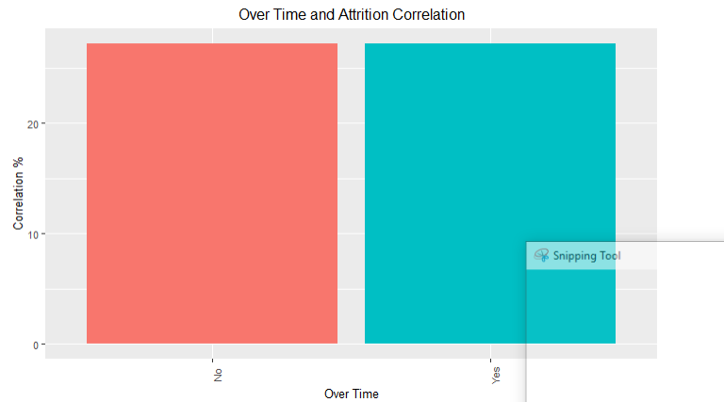
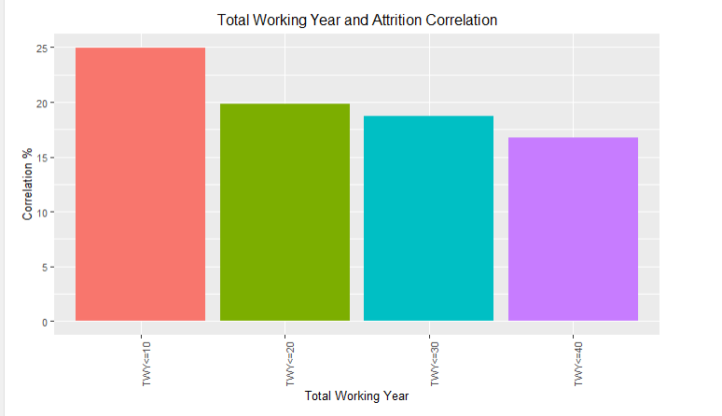
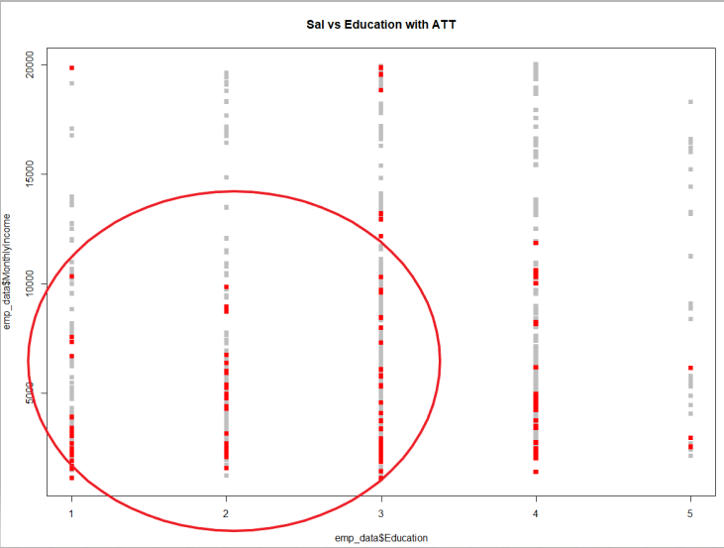
Correlation of Attrition and Attributes
Lower jobs have a high attrition
Lower salary and low age are more susceptible to attrition
Single Employees have high attrition
Over Time shows more than a 20% correlation
Total Working Years show more than a 20% correlation
Low salary and low education are more vulnerable to attrition

Slide 7
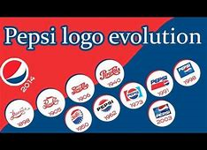
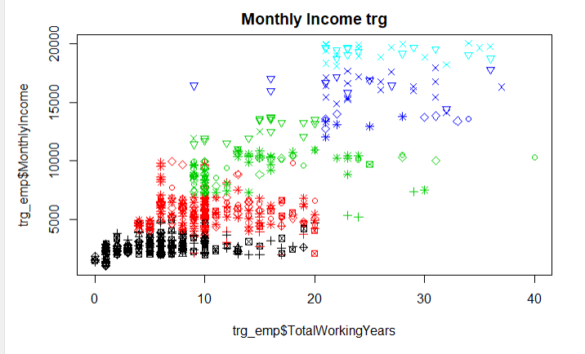
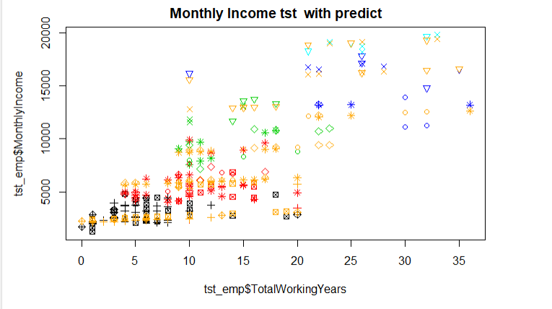
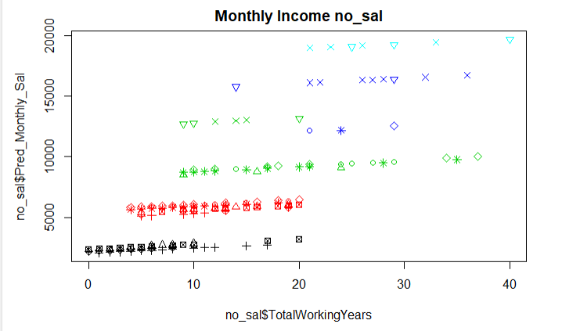
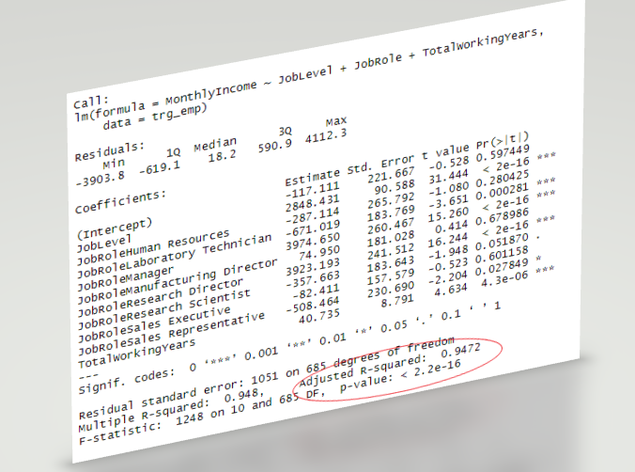
Monthly Salary Model
Monthly Income with Trg Data (fig1)
Monthly Income with Test Data (fig2)
Monthly Income with no_sal Predict (fig3)
Confusion Matrix and Statistics
Model Summary show
Very low value of p (p-value: < 2.2e-16)
Adjusted R-squared: 0.9472
RMSE(Route Mean Square Error is $1,116/= (far lower than $3,000)
Monthly Income test data and predicted Monthly Sal looks very aligned (fig2)
no_sal data with predicted Monthly salary also looks aligned (fig3)

Slide 8
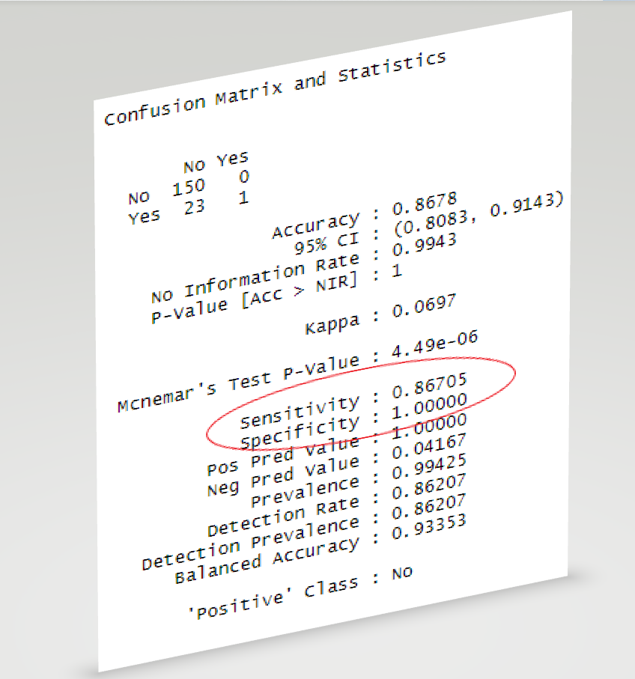

Attrition Model
Built a KNN (K Nearest Neighbor) model to predict attrition.
Used two prime attributes to predict attrition:
Job Level
Total Working Years
Confusion Matrix
Built a KNN model with Accuracy of 86.78%
Very low p-value 4.49e-06
Sensitivity of 86.71%
Specificity of 100%

Slide 9
Conclusion
Keep focus on young employees and build better education/ training program to minimize turnover
Review financial package like stock options to earn employee loyalty and binding
Build special training program for employee at lower level to reduce their attrition vulnerability
Balanced work to minimize over time

Slide 10


